Slide 1







Image Compression & Segmentation Workflow
Data Acquisition
Data Compression
Data Preprocessing
MMSegmentation Compatible format
Training RGB Images
Ground Truth Images
Q = 0.25
Q = 0.75
Quality levels
GT Image
Segmented Image
mIoU, and Heatmap Generation
labels
labels
Image Segmentation
Label Mapping for consistent comparisons
Using DeepLabV3
Tushar Rewatkar
Notes:
Data Compression: Useed IMAGE MAGICK

Slide 2
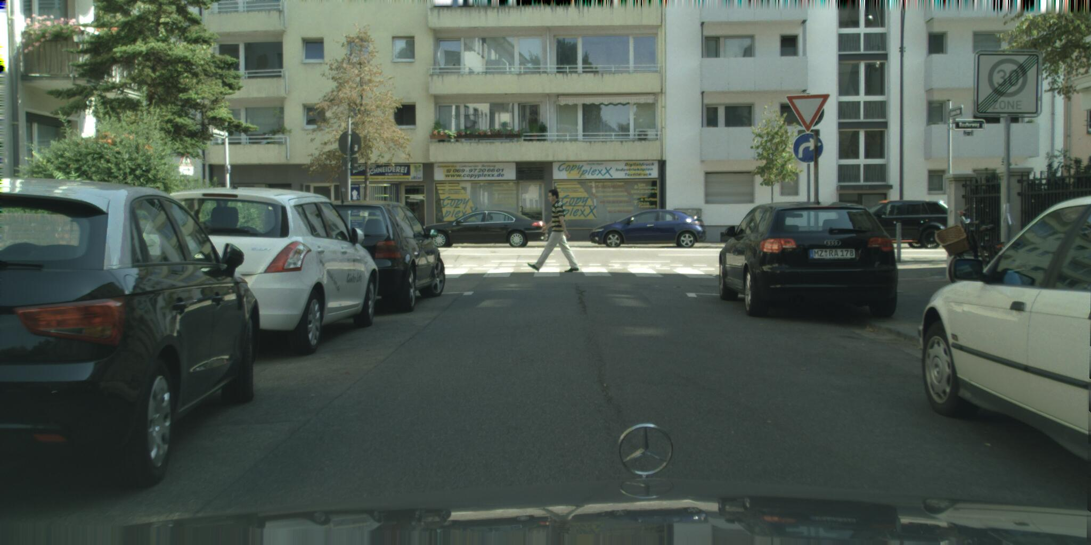
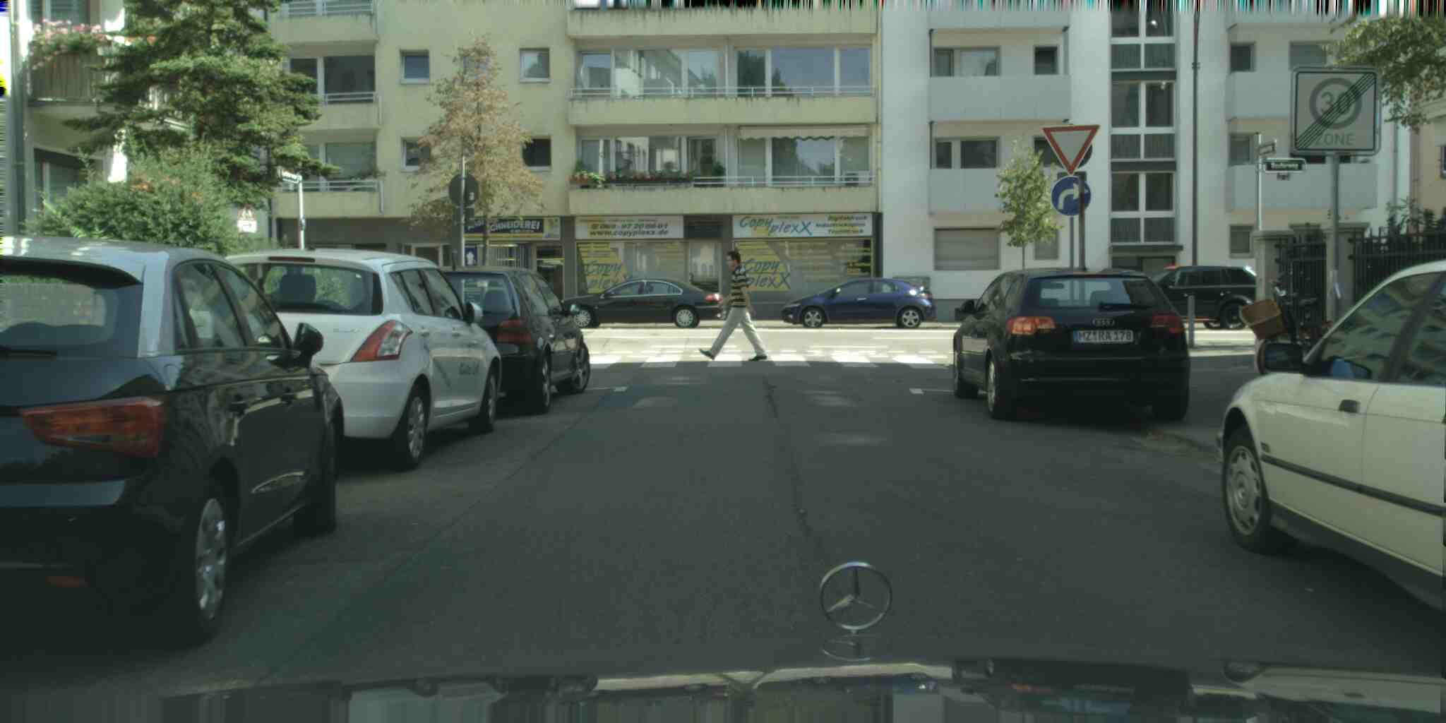
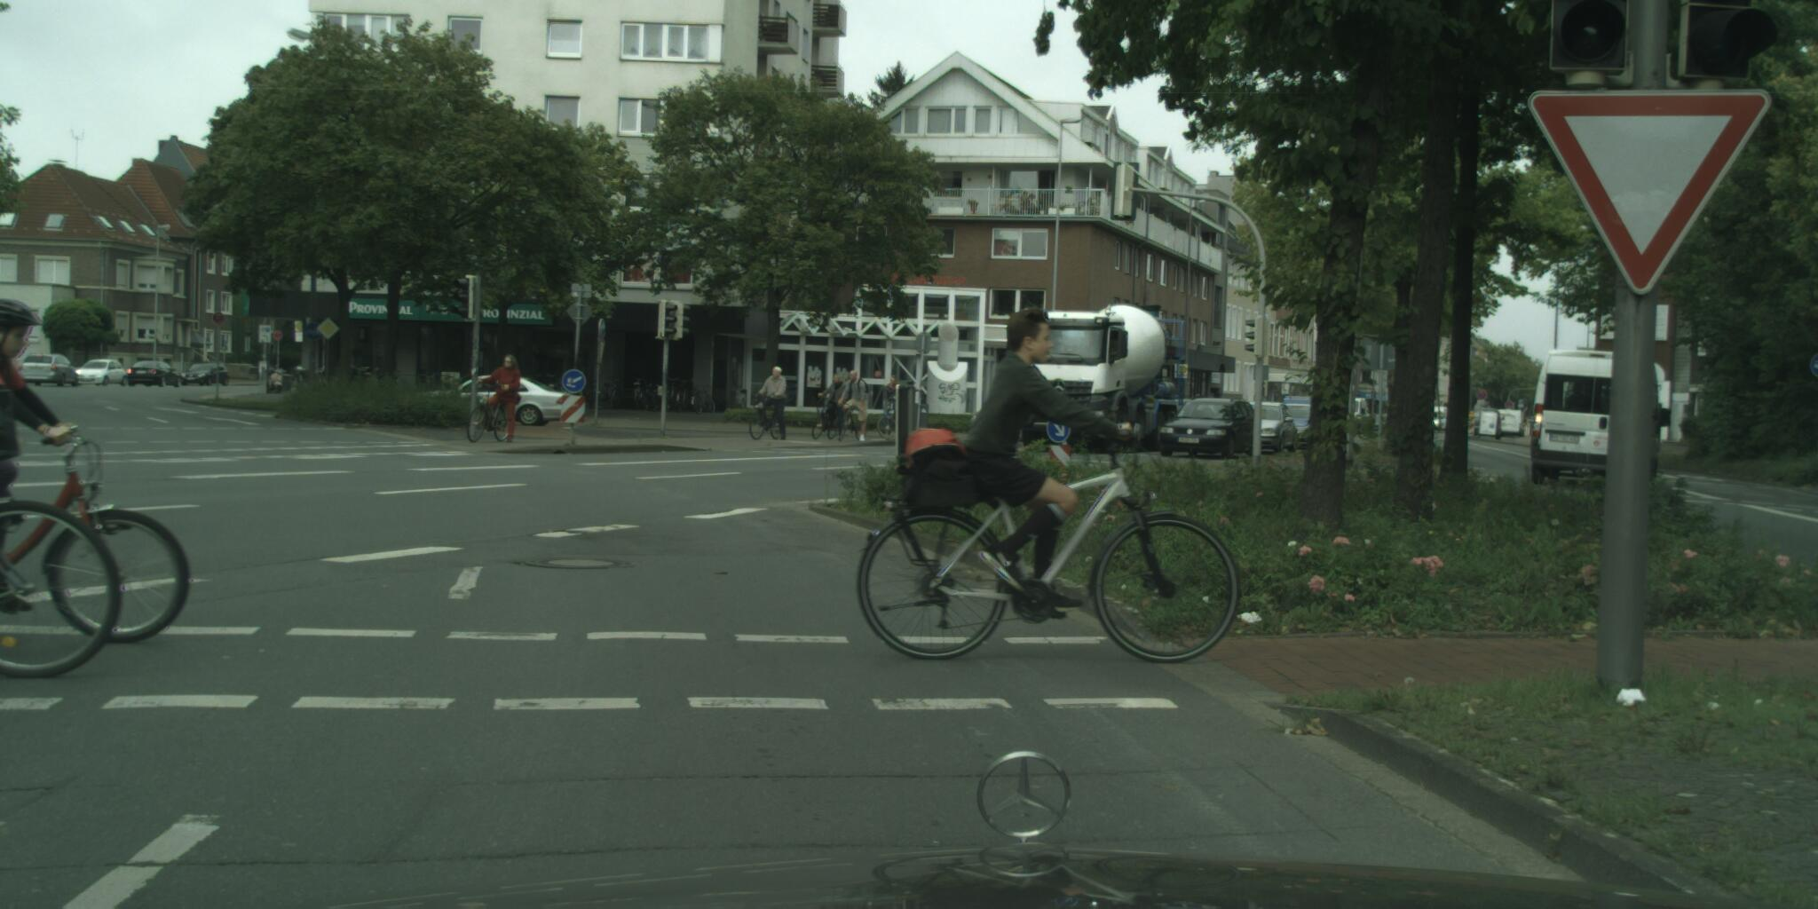
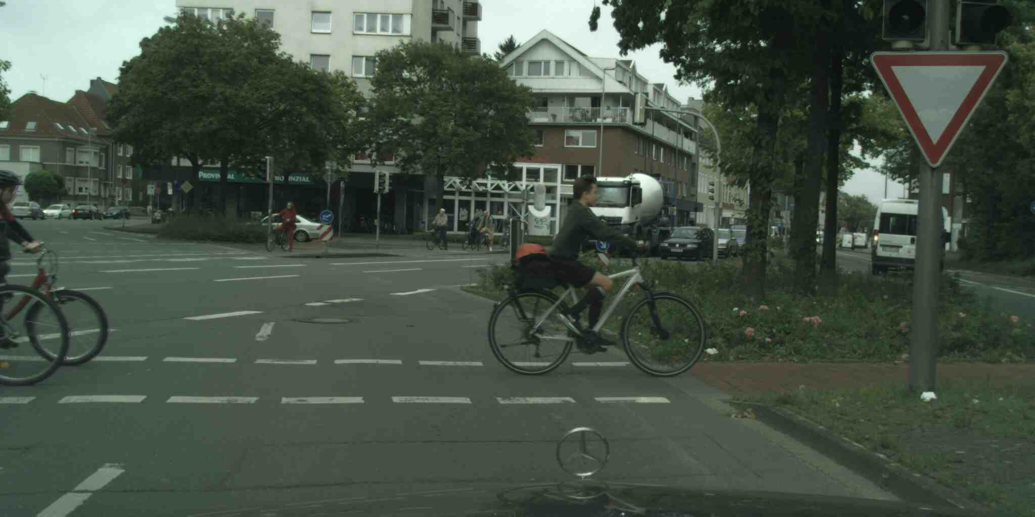
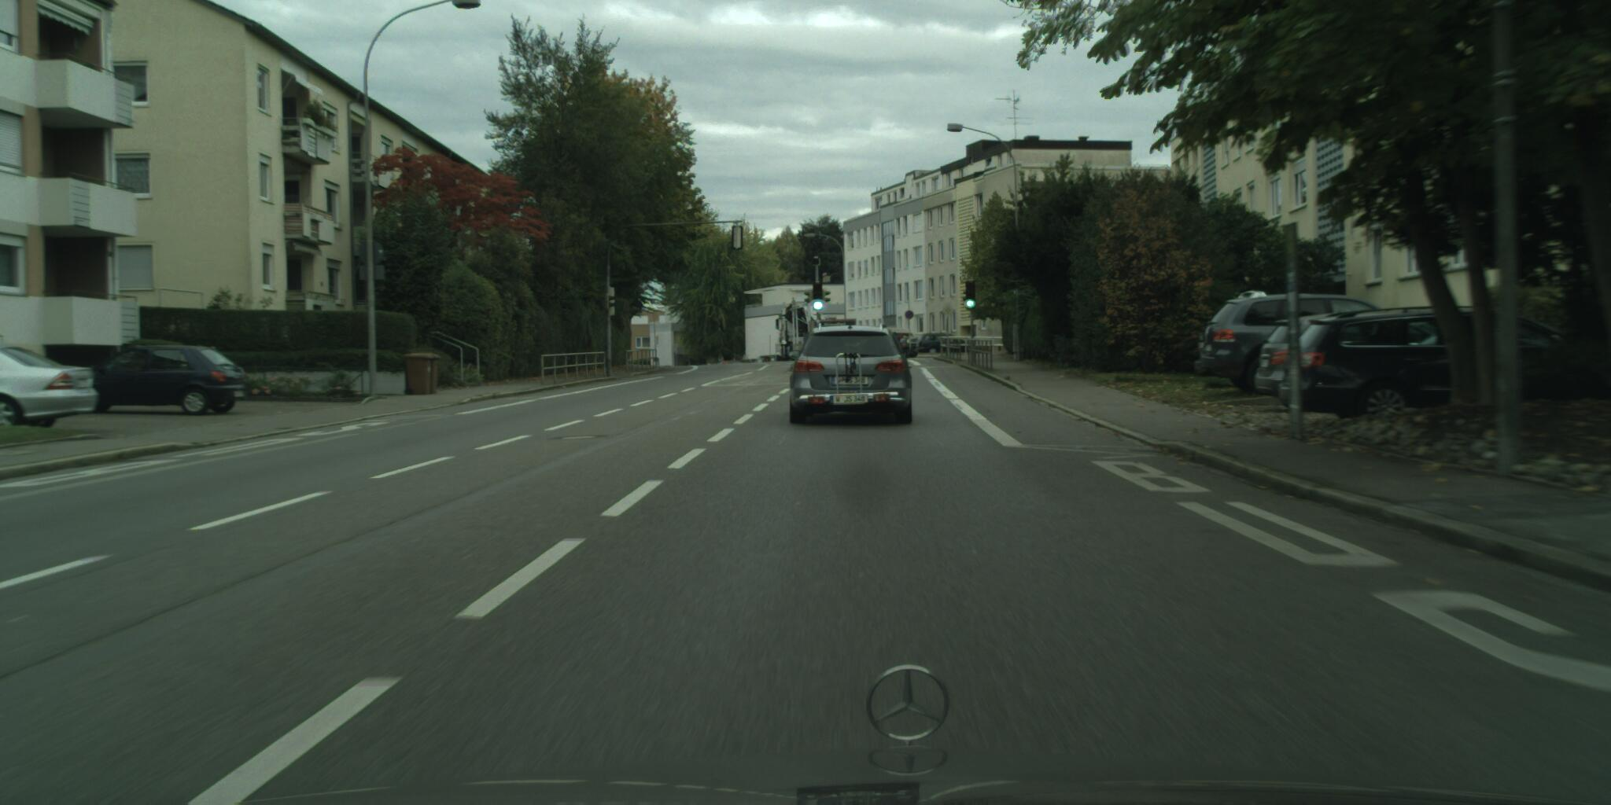
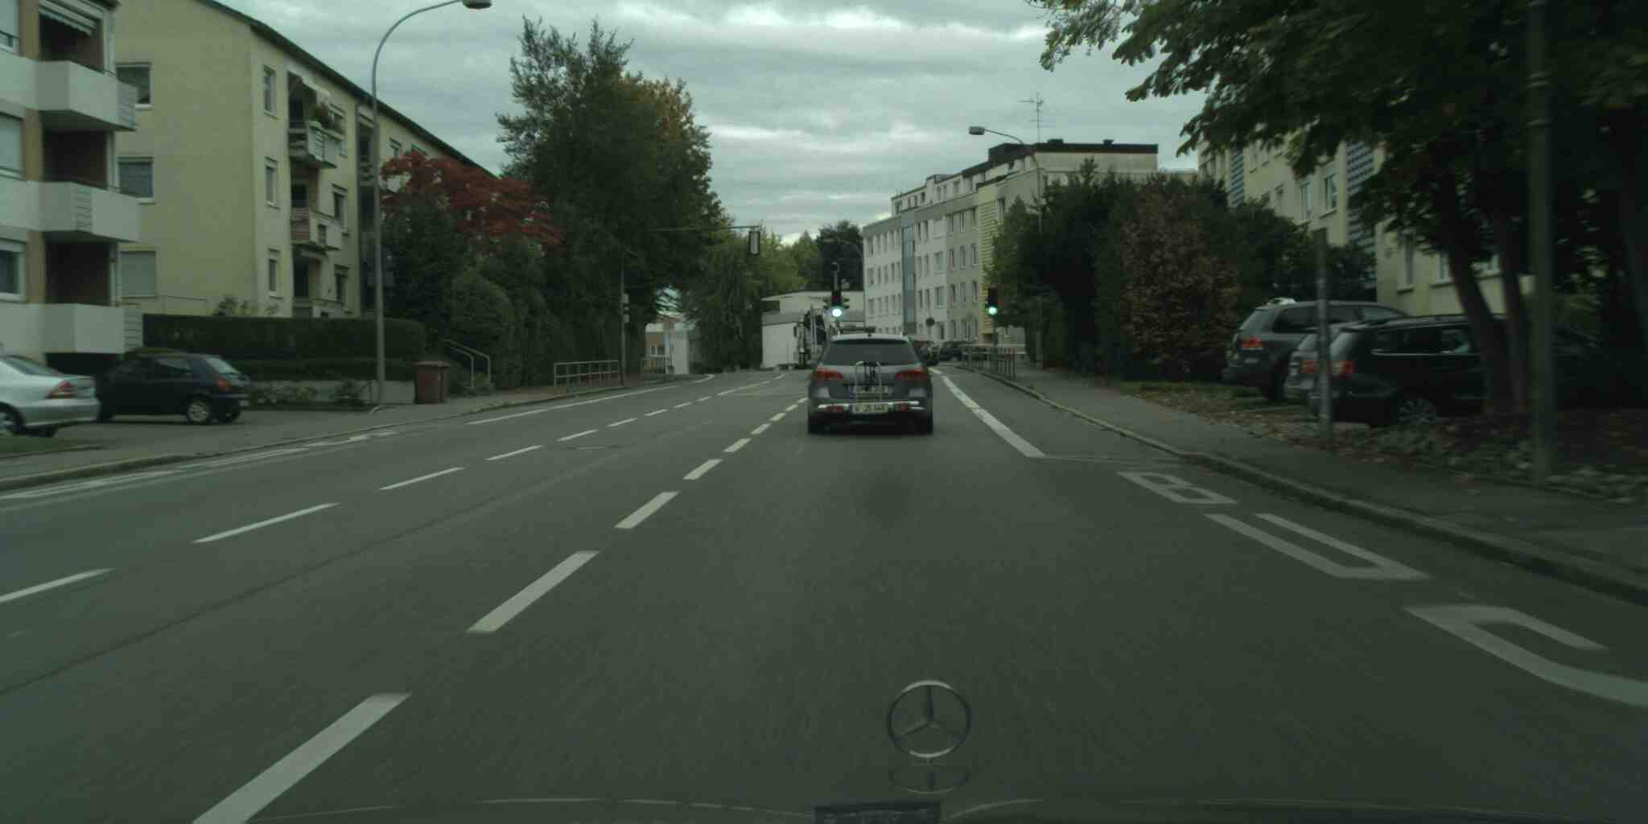
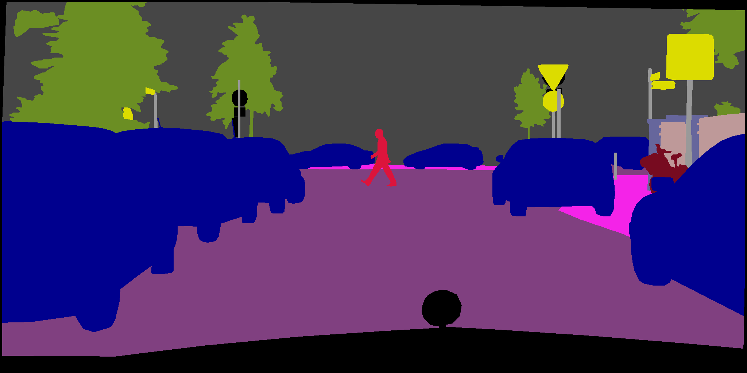
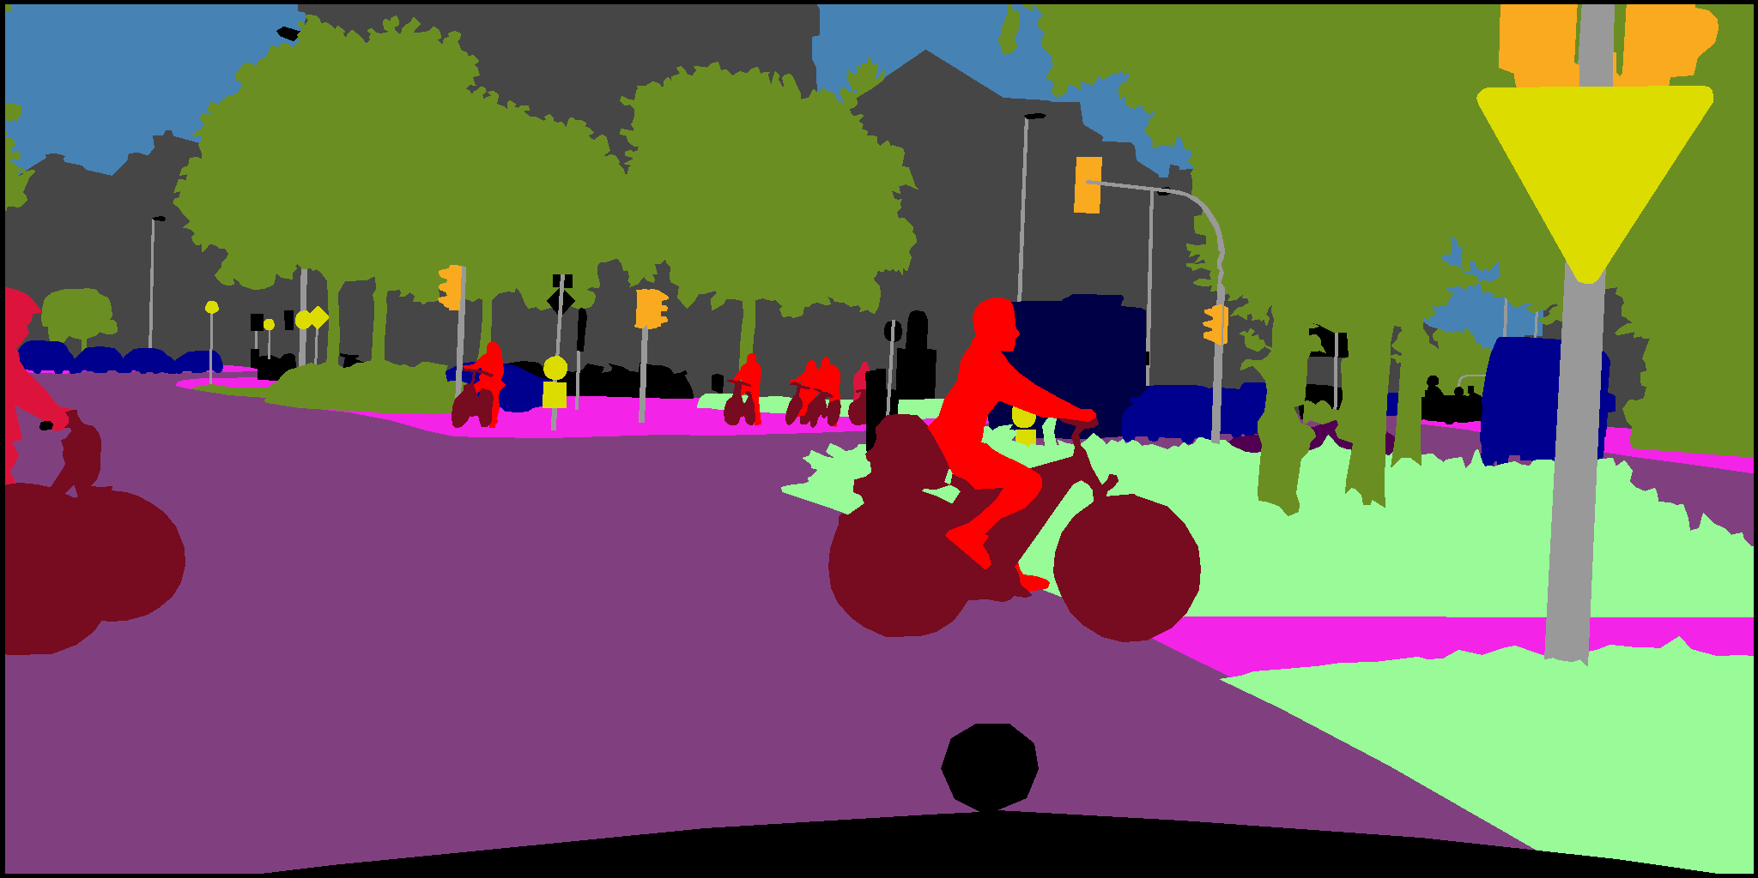
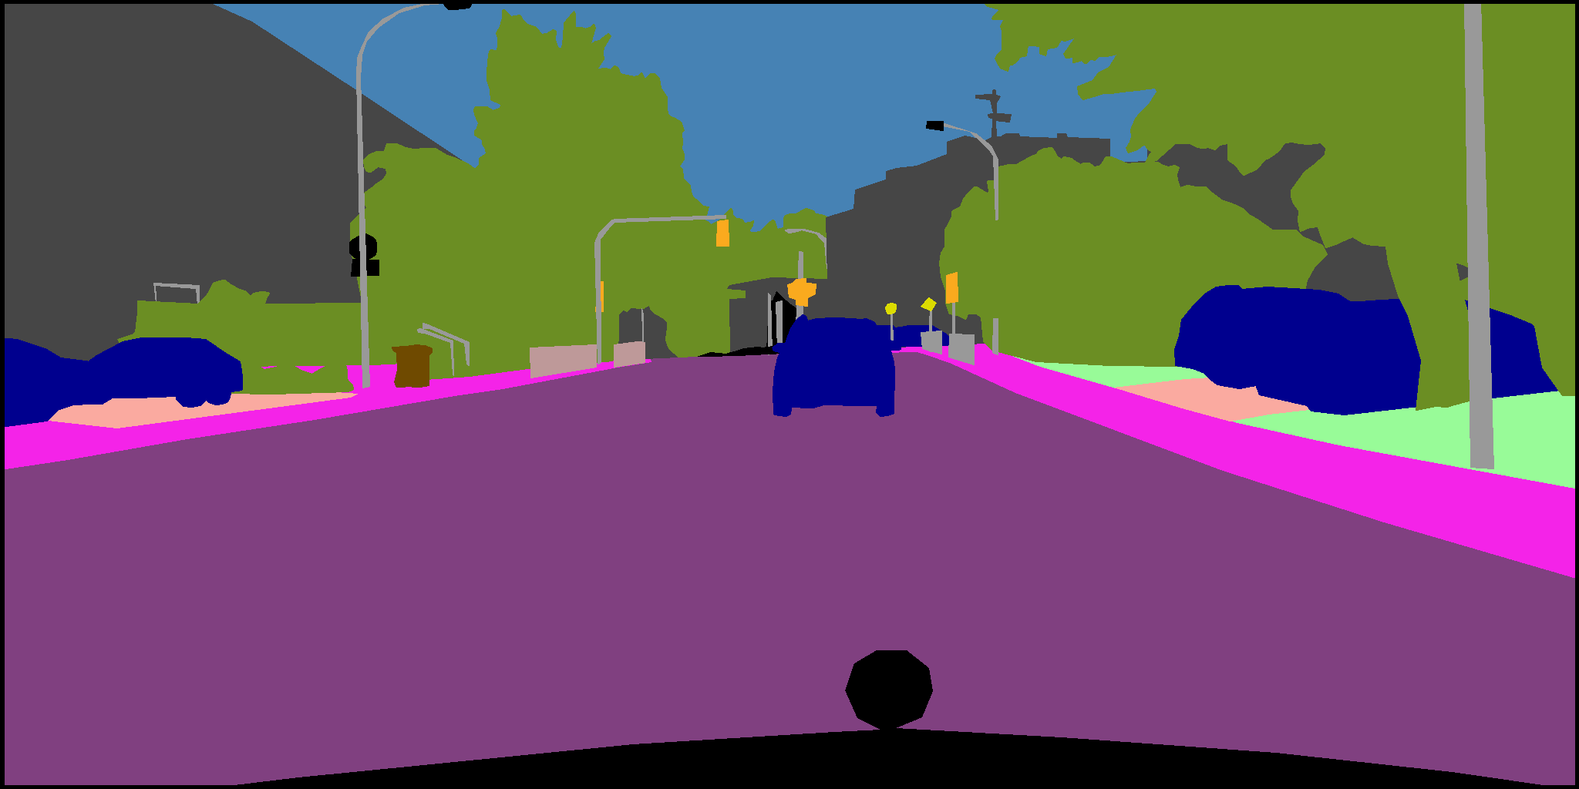
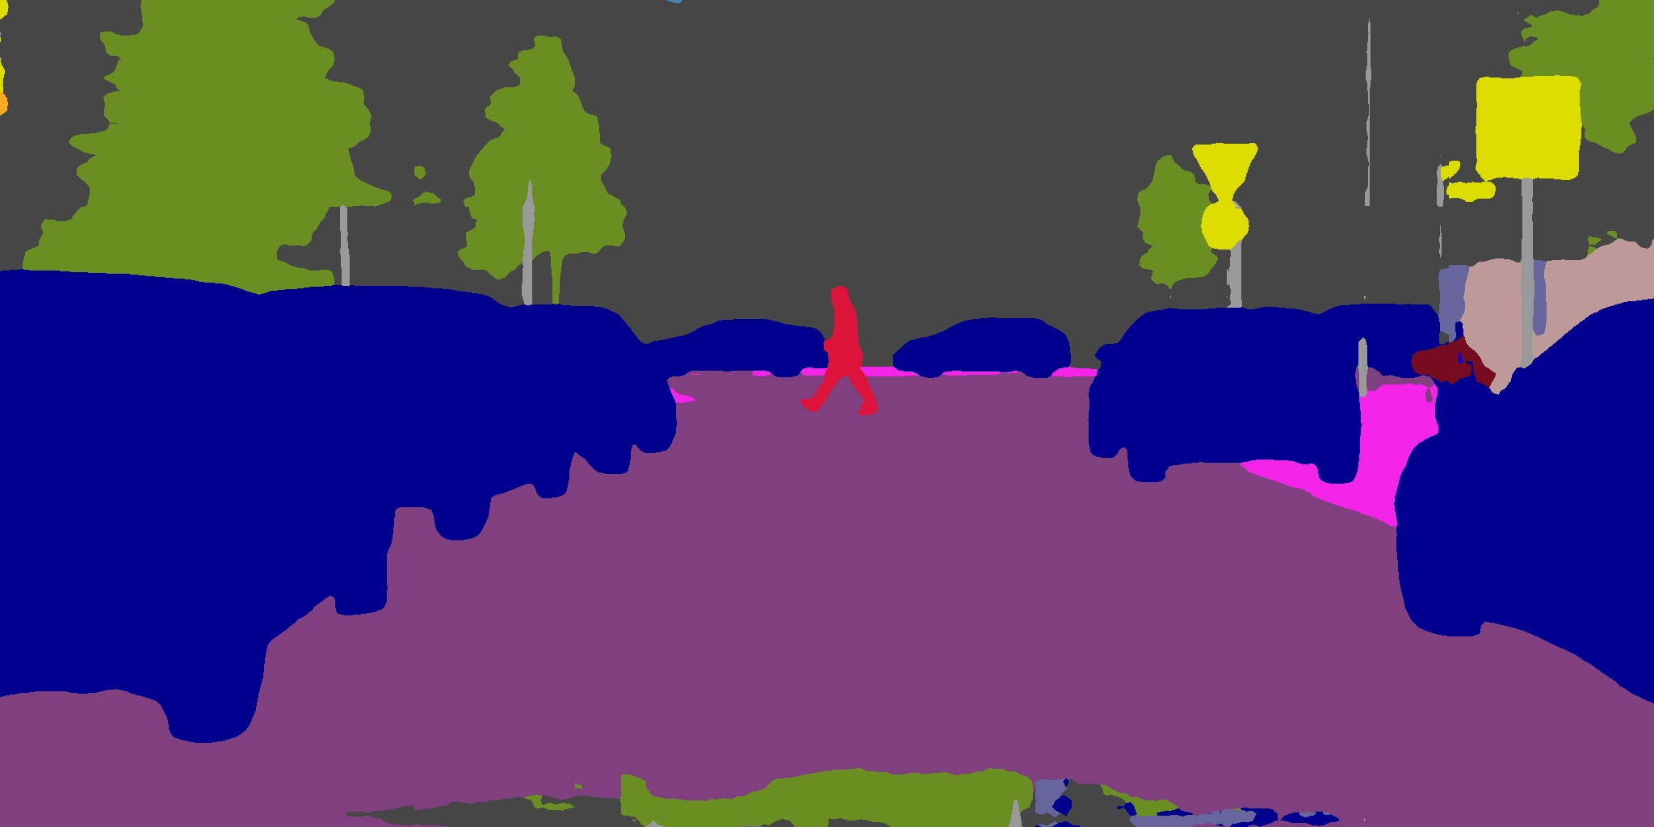
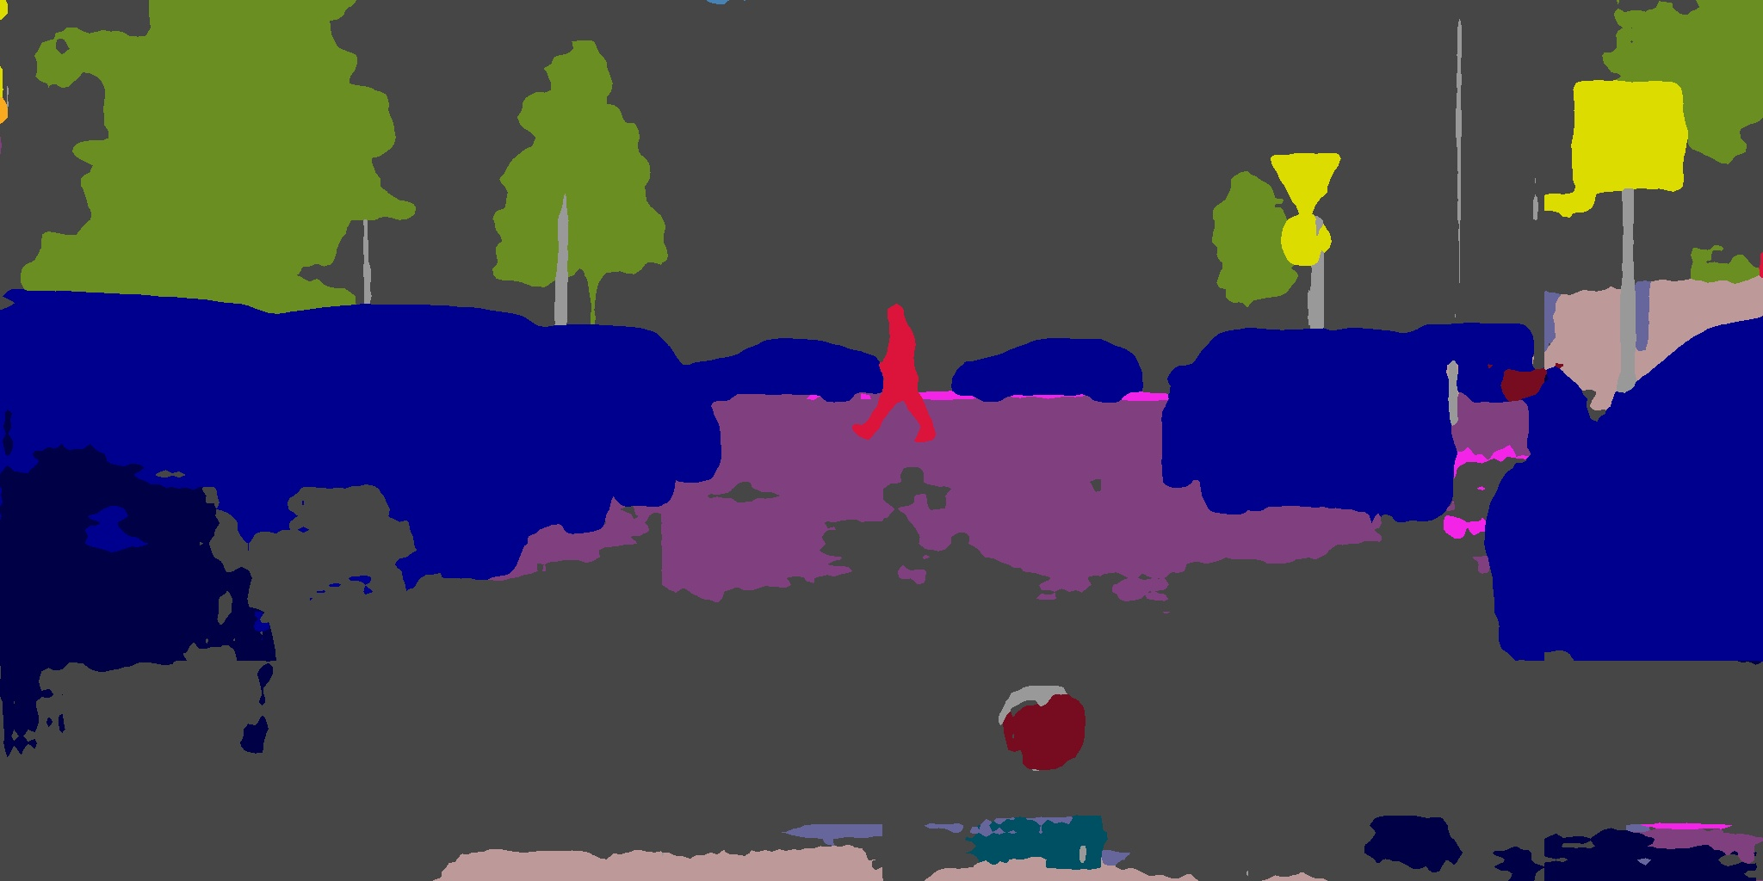
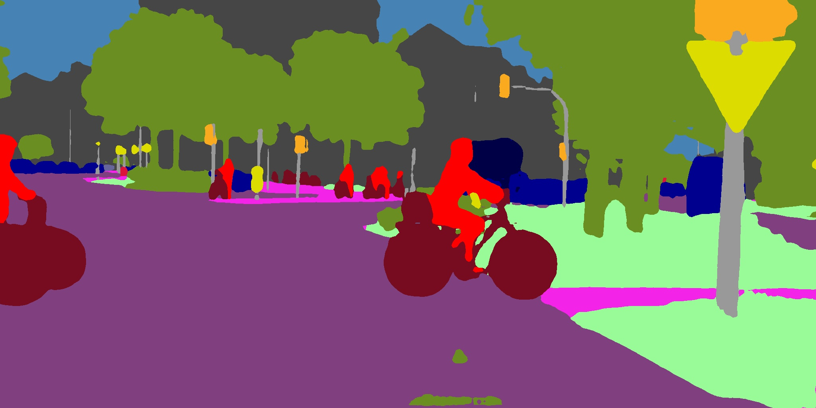
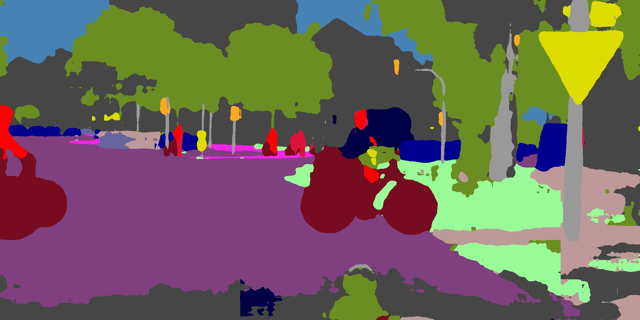
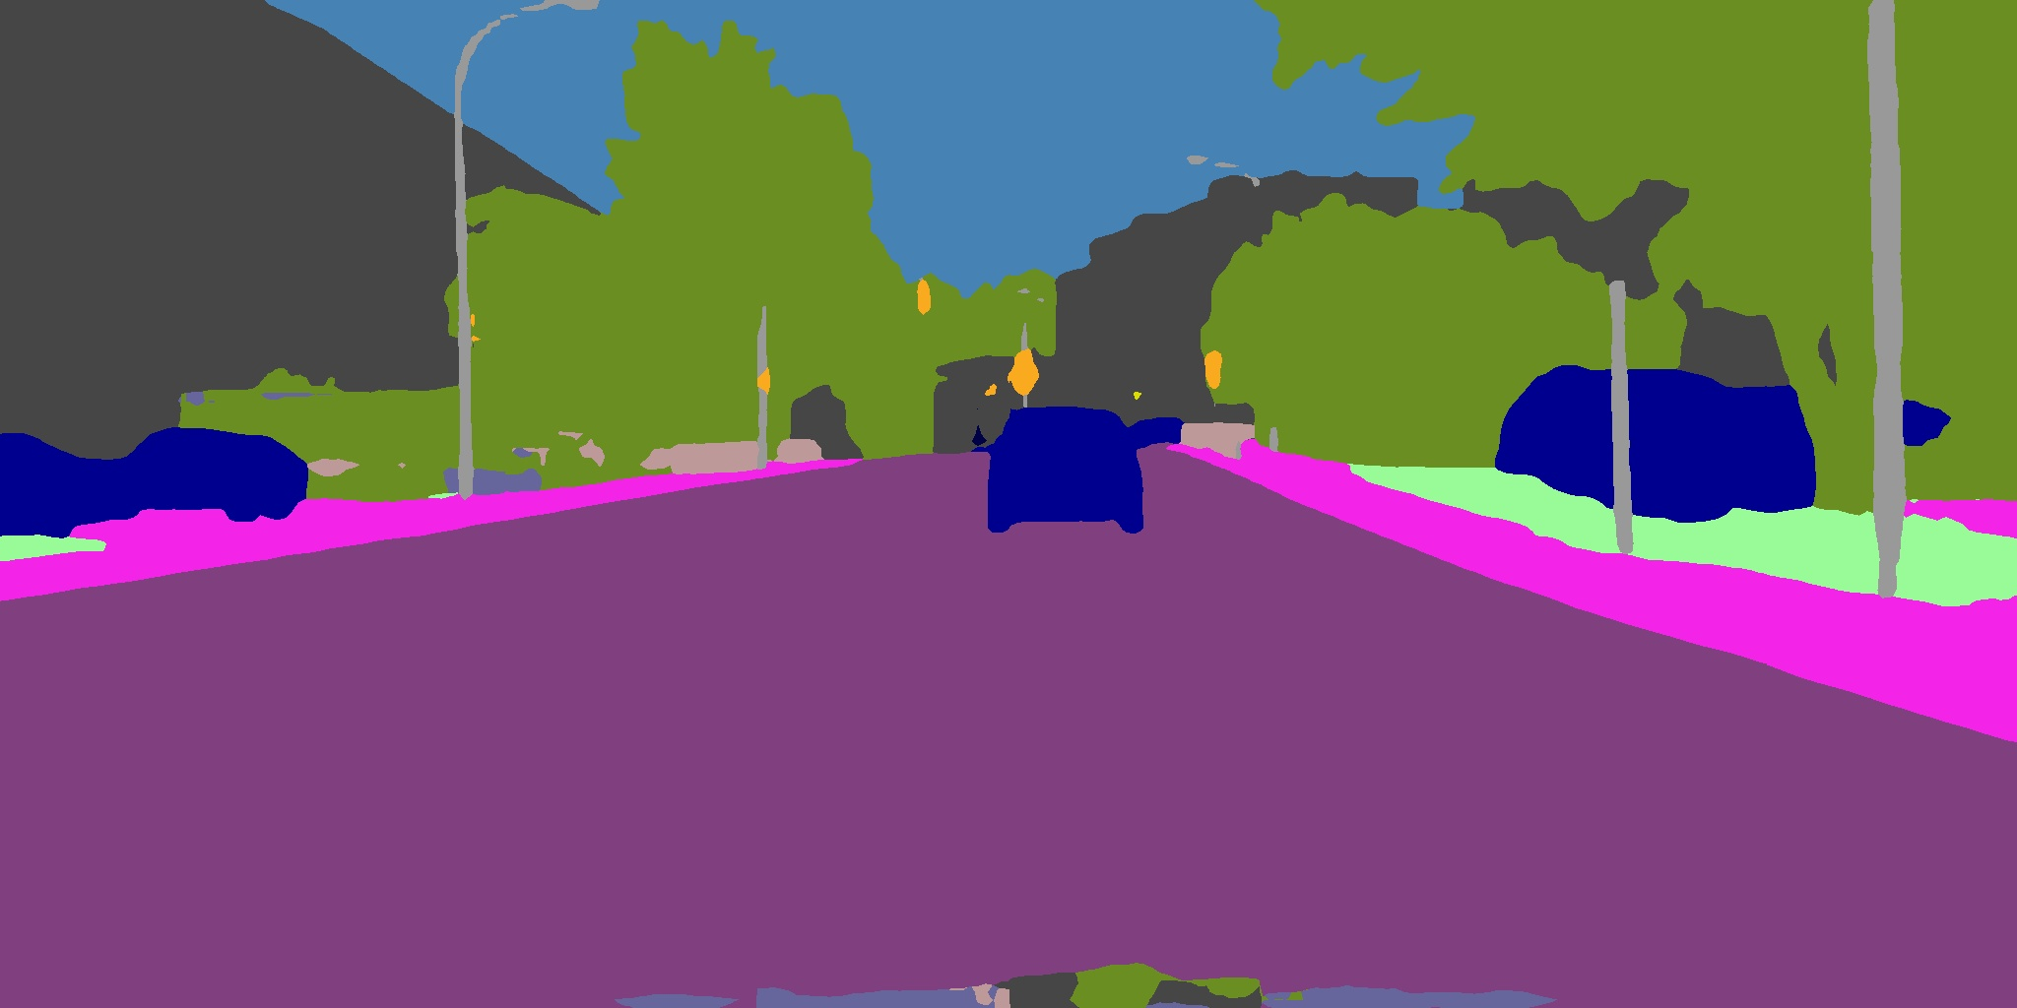
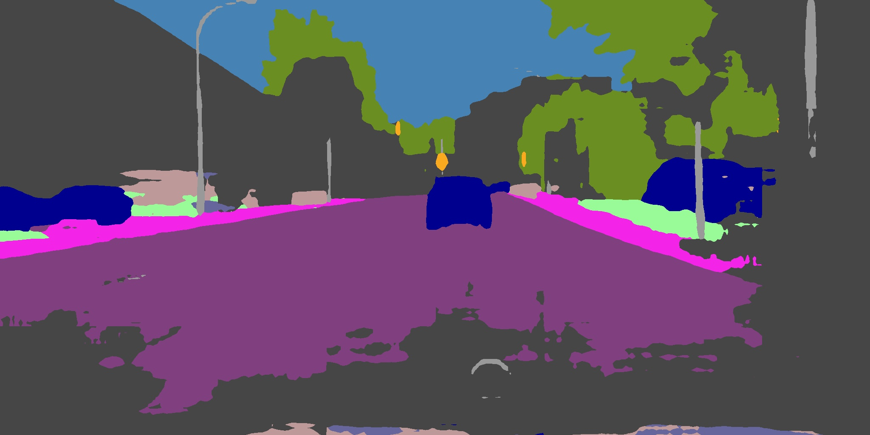
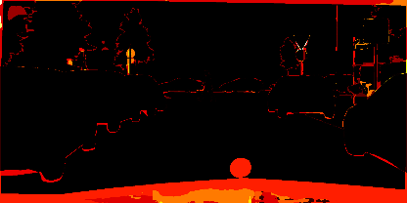
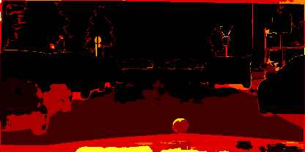
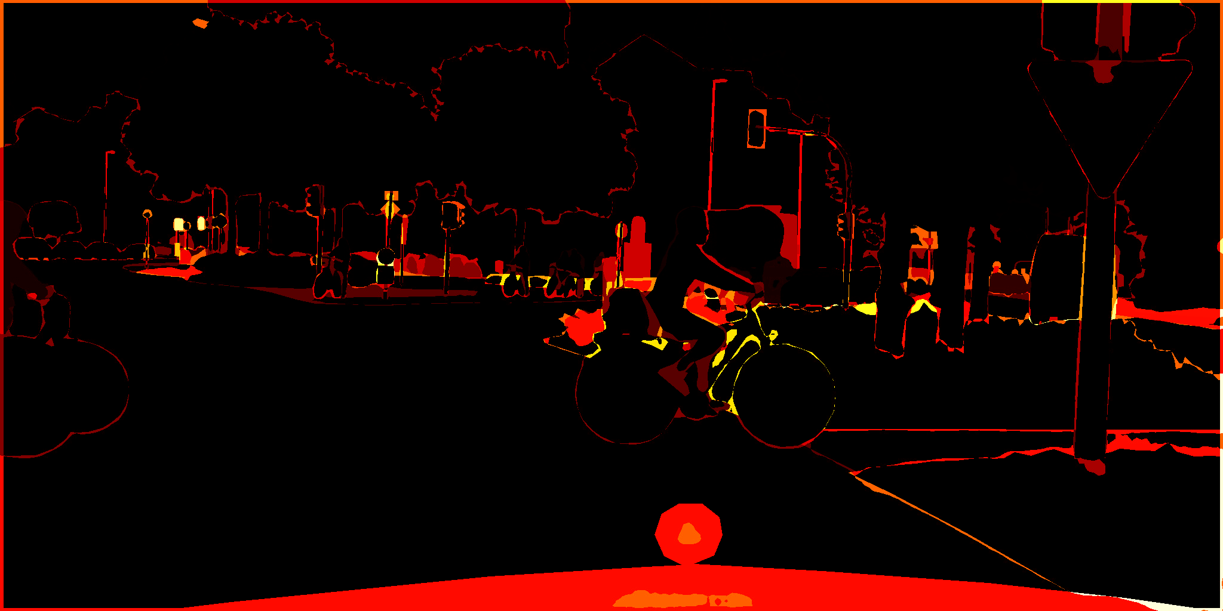
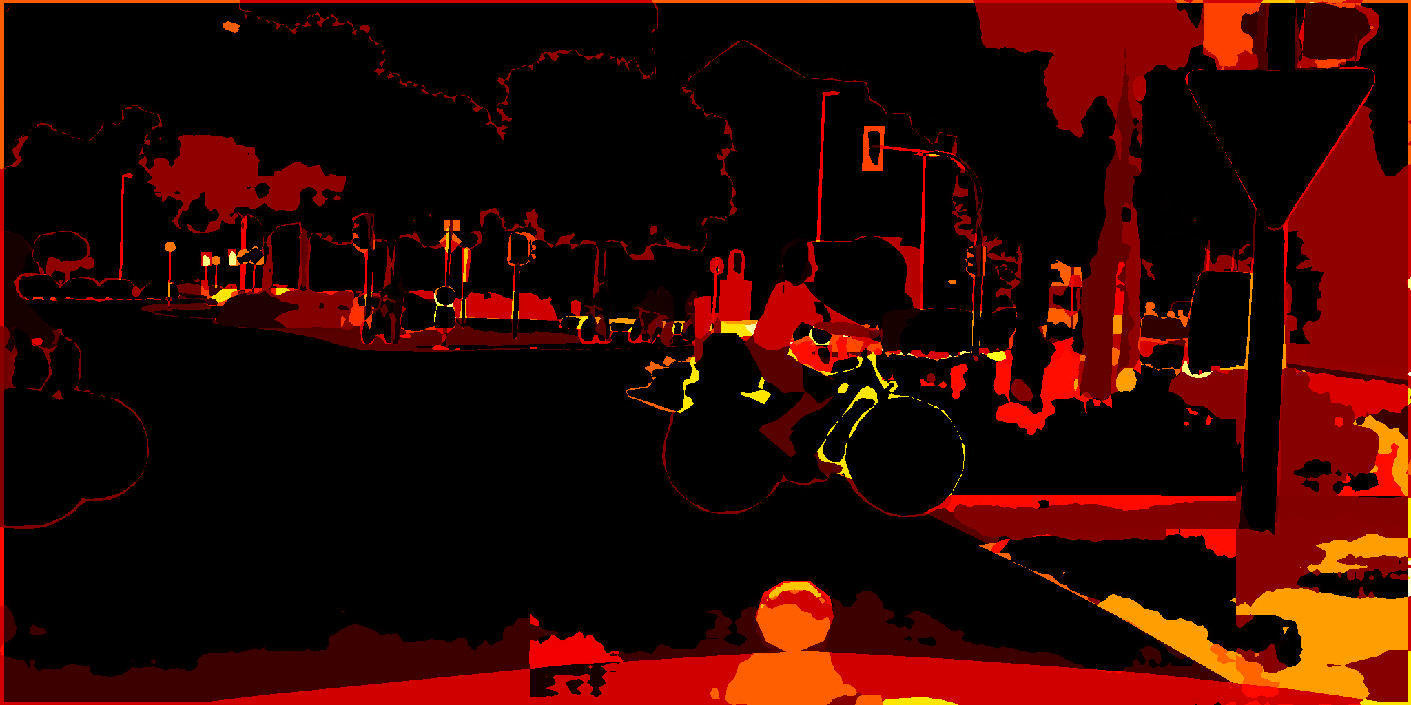
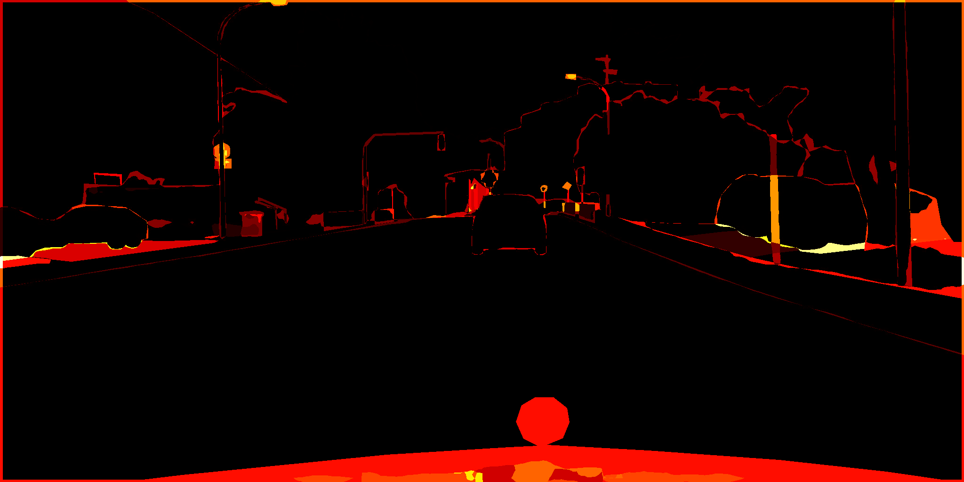
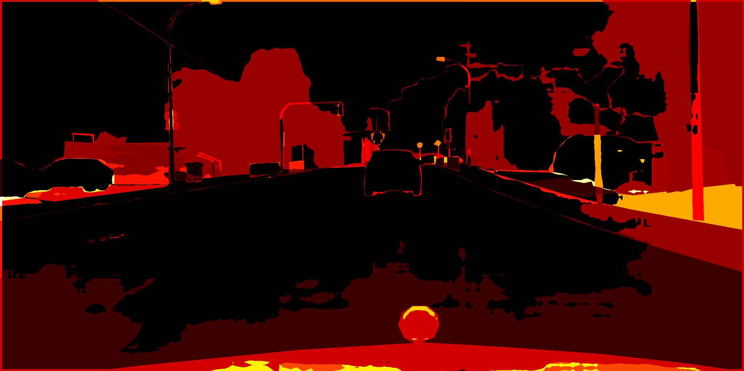
Qualitative Analysis
Q = 0.75
Q = 0.25
Q = 0.75
Q = 0.25
Q = 0.75
Q = 0.25
Compressed Images
Ground Truth Images
Segmented Images
Error Heatmap
Frankfurt
Munster
Lindau
Tushar Rewatkar

Slide 3
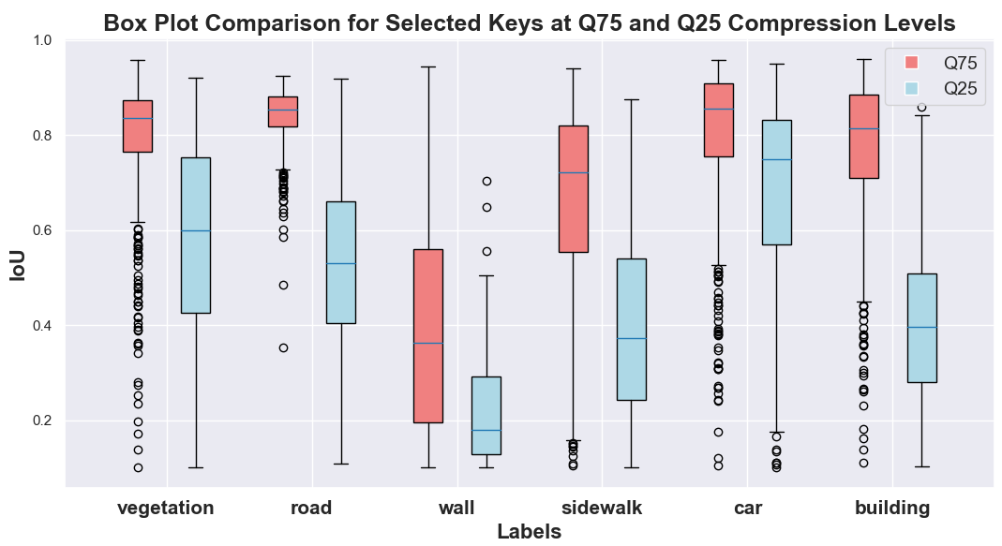
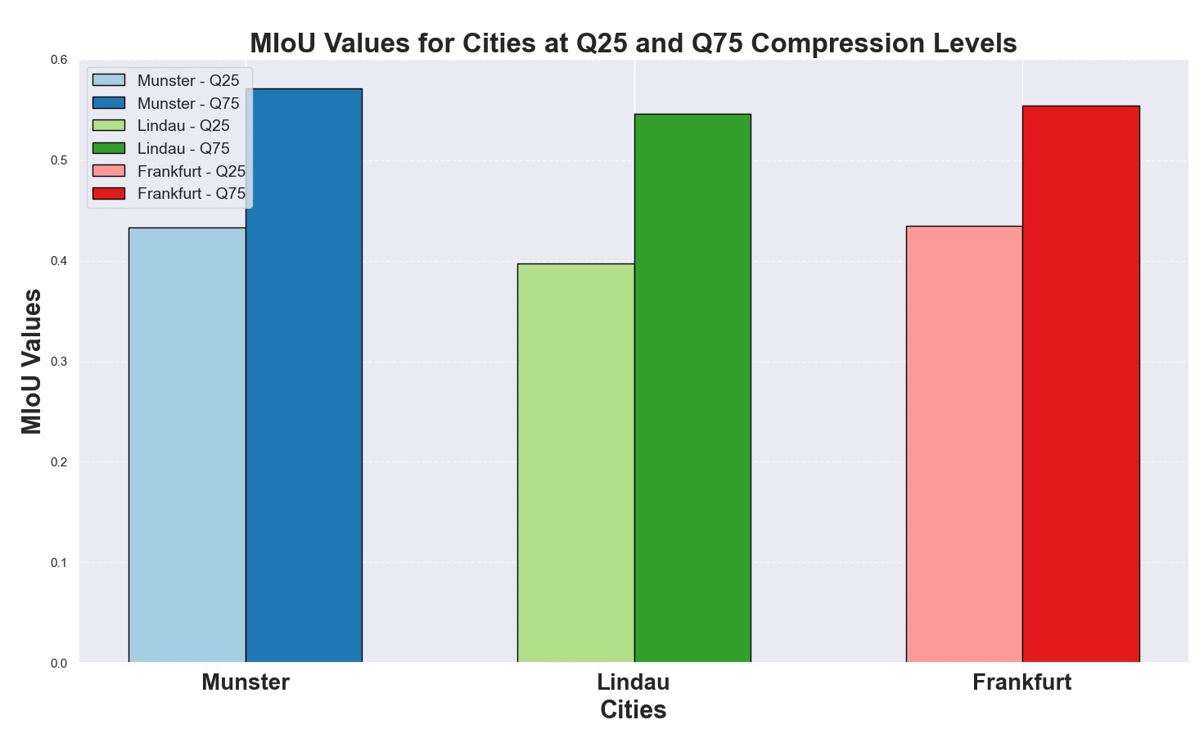
Quantitative Analysis
It shows the Mean Intersection over Union (mIoU) values per city separately for images at quality levels Q25 and Q75.
It illustrates the comparison of IoU values for unique labels across images from the cities of Lindau, Munster, and Frankfurt at quality levels Q25 and Q75.
Tushar Rewatkar

Slide 4
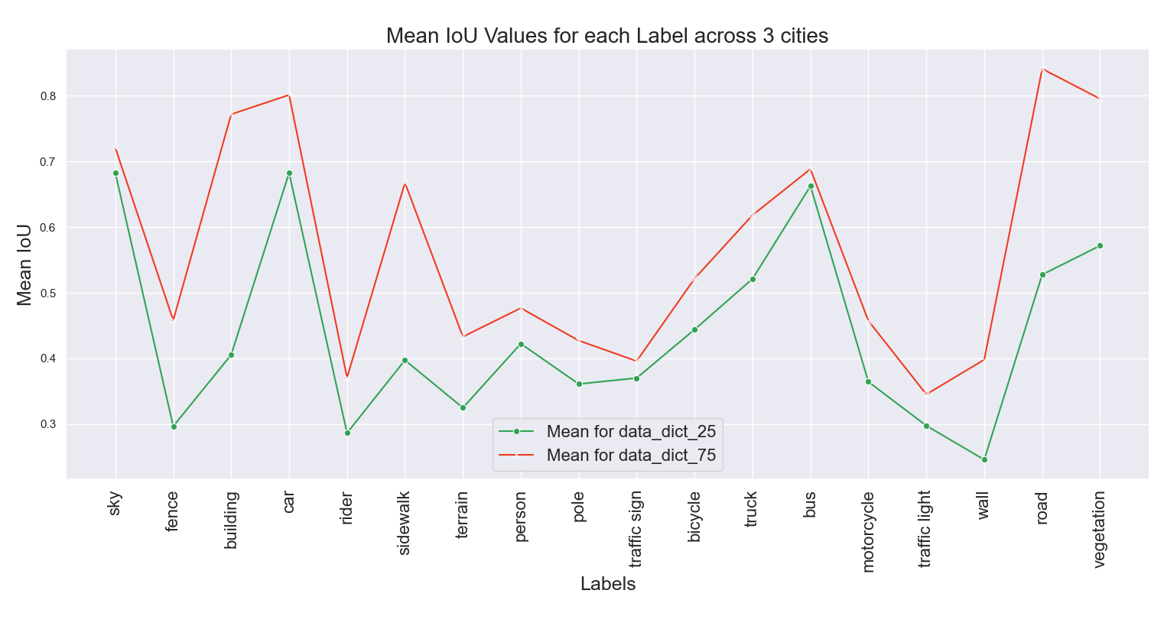
Quantitative Analysis
It illustrates the comparison of MIoU values for unique labels across images from the cities of Lindau, Munster, and Frankfurt for both quality levels.
Tushar Rewatkar

Slide 5
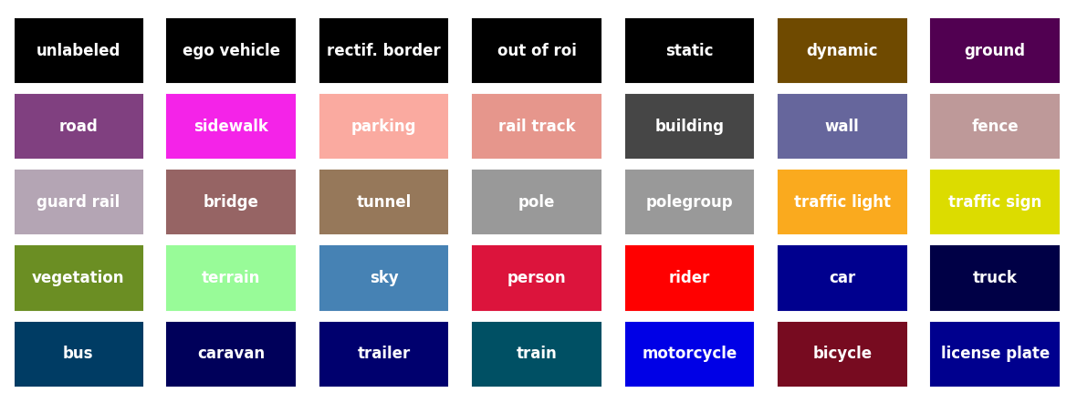
Obstacles and Observations
Mapping Labels
Challenge: Mapping labels to colors.
Solution: Assigning labels by calculating minimum Euclidean distances
between pixel colors and a predefined set of mapping labels.
Distinct colors from segmented Image
References
1) https://github.com/mcordts/cityscapesScripts/blob/master/cityscapesscripts/helpers/labels.py
2) https://www.kaggle.com/code/levusik/semantic-segmentation-pytorch-unet-enet-esnet#Introduction
3) https://www.kaggle.com/code/tr1gg3rtrash/car-driving-segmentation-unet-from-scratch
Tushar Rewatkar

